Slide 1
COMP 51 Week One
High Level Languages
C++ Basics

Slide 2
What are we Talking About?
Language Levels
Introduction to C++
Program Style
Libraries and Namespaces

Slide 3
Why Do We Care?
It’s important to know where we’ve come from!
“Those who do not remember their past are condemned to repeat their mistakes.” George Santayana.
Programming is part of product development process, not the whole!

Slide 4
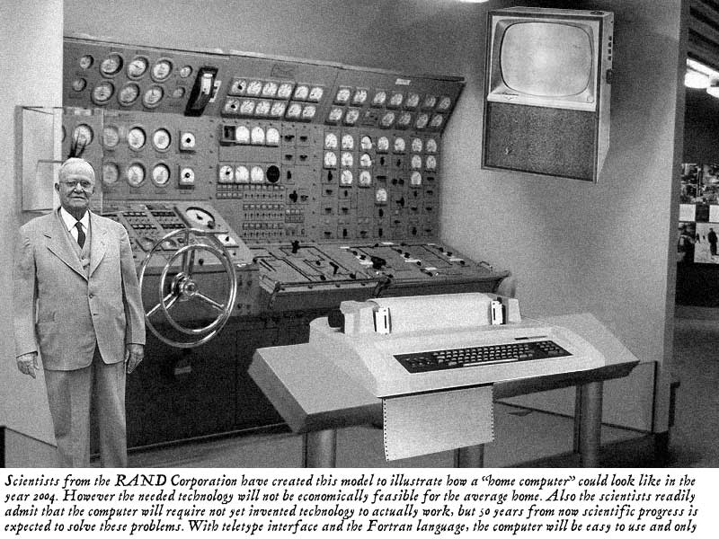
HOAX!

Slide 5
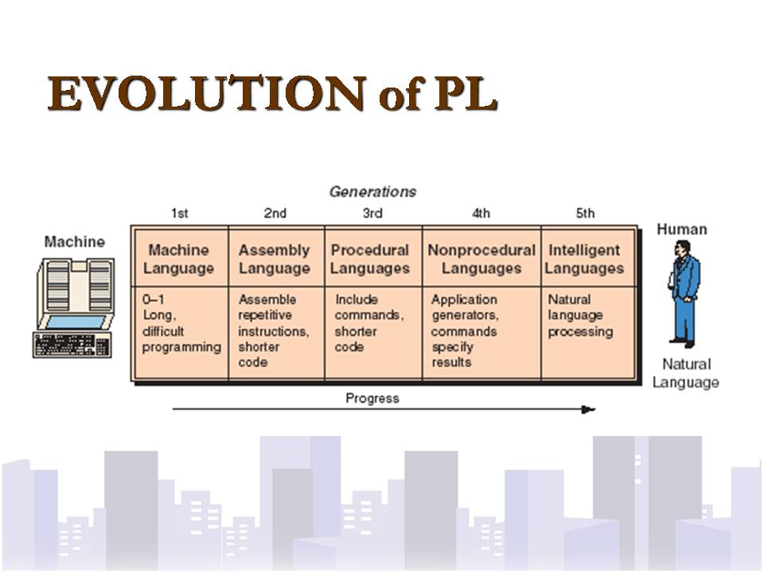
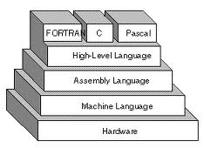
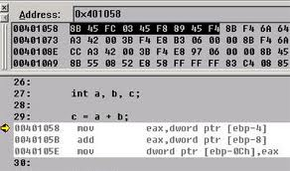
Notes:
1950, mainframe computers, used binary code because easy for electrical engineers, difficult programming.
1960, assembly language, simple maths, can work with architecture of computer. Example computer architecture. CPU processes data in registers (electrical hardware that stores data to be processed), RAM transfers data from CPU and STORAGE. Example of assembly language, bottom right picture. Assembly tells the computer “what” and “how” to do something.
1970, procedural language, C is born, language tells computer more about “what” to do than “how” to do. Language becomes more readable, but needs to be converted, or “compiled”, back into machine language.
1980, 4th generation language. Object Oriented Languages born. Databases become popular. SQL language born. Spreadsheet languages born, etc. Excel.
1990 and up to today, 5th generation language. Natural Languages.

Slide 6
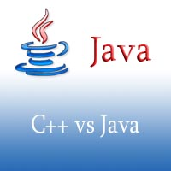
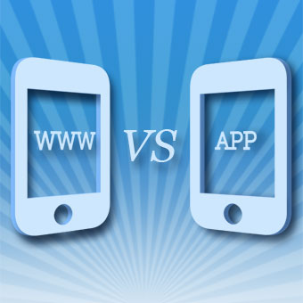
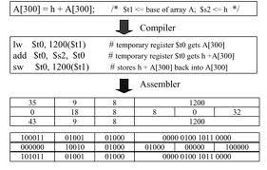
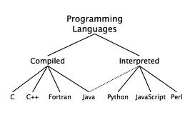
Compiled vs Interpreted
Notes:
Compile. Converts readable code into machine code. Windows .exe macOS .bin. No need source code to run.
Interpret. Takes source code, converts to chunks, reads each line, converts to machine code. Faster for shorter code.

Slide 7
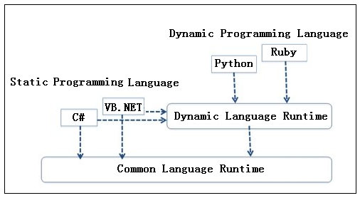
Compiled vs Dynamic
CLR is Microsoft’s attempt to provide multi-language support for Windows
Notes:
Taken from - http://dotnetslackers.com/articles/csharp/Dissecting-C-Sharp-4-0-Dynamic-Programming.aspx
Developers can adjust the code at any time. Whatever functions are required just directly add them to the dynamic object, while whenever they are not needed remove them. And that, such changes can take effect immediately, not needing to modify the definition and declaration as C#; and also, only when the new method is successfully compiled can it be used again.
In other words, in using a dynamic programming language, the iterative development process is pretty quick and clear-cut.
Type parsing is done at run time
Type analysis in dynamic programming languages is completed at the running time, without much unnecessary type conversion code. So, compared with the static programming languages, code written using dynamic programming languages is often more compact, less volume.
At the same time, dynamic programming languages have two major weaknesses:
(1) Many errors in the code can be found out until runtime, as well as require a specific runtime environment support. So, testing it is not convenient, nor is it difficult to support many of the various software engineering tools that are used to improve the quality of the code. Therefore, dynamic programming language is not suitable for developing larger-scaled, complex logic applications.
(2) Compared with the static programming languages, dynamic programming language programs bear low performance. However, with continual development of computer hardware and software technology, such as extensive use of multi-core CPU, optimization of dynamic programming language engine and runtime environment, application performance written with dynamic programming language continues to improve, in particular contexts, even comparable to that in the static programming language.

Slide 8
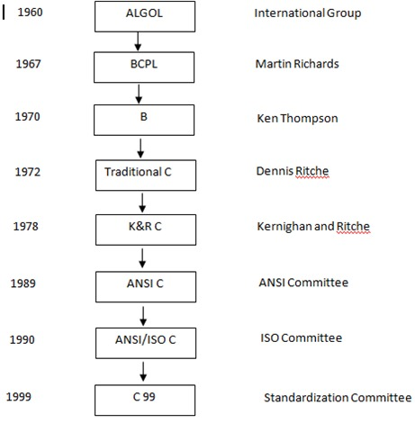
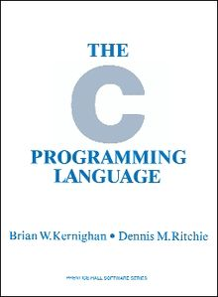
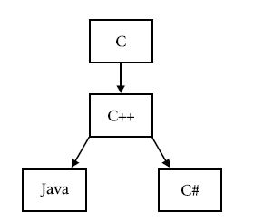
The C Family Tree and Timeline
Where it all started – the C “Bible”
Notes:
ALGOL – first attempt at 3rd generation language, procedural
Traditional C – Dennis Ritche, Unix invented

Slide 9
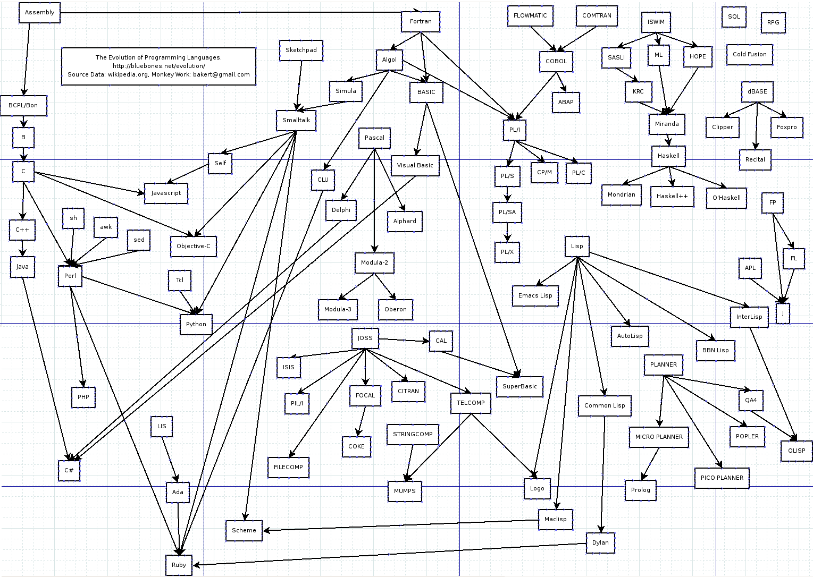
Spot the Language!

Slide 10
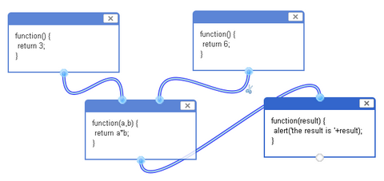
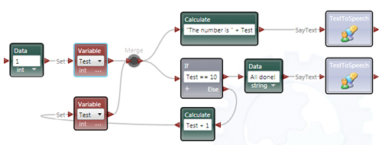
Next Gen - Visual Programming
Note the links between output handles and inputs

Slide 11
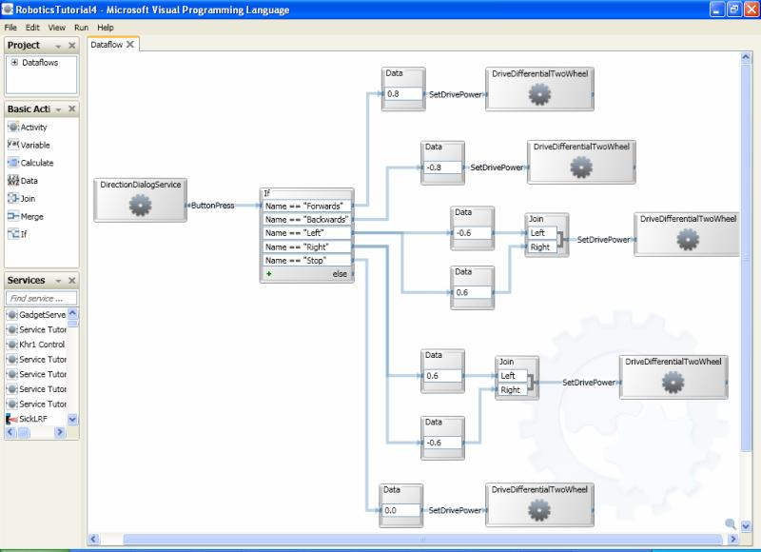
Robotics Example

Slide 12
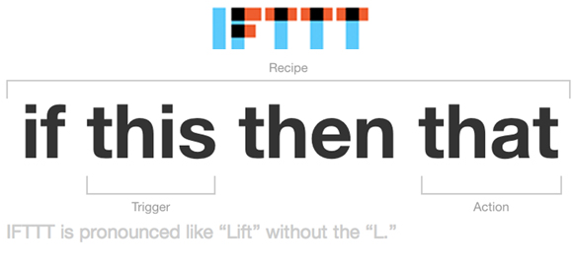
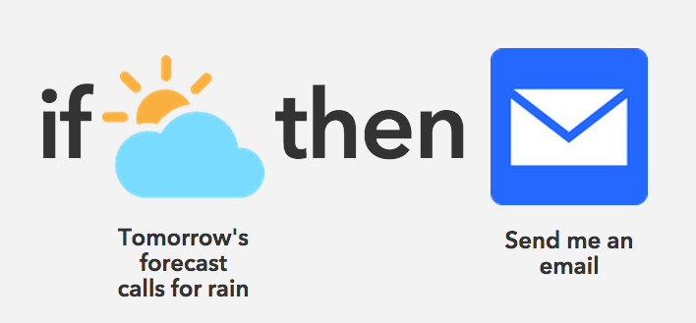
Simple Graphical Conditions

Slide 13
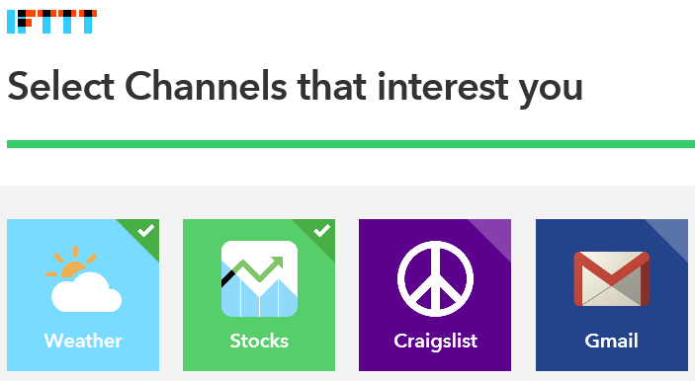
Create IFTTT Account Go to ifttt.com

Slide 14
IFTTT Programs
Programs are called Applets
Login and select channels of interest
Then click on My Recipes
Press the Create Recipe button
Choose a trigger
Select category = Weather Underground or Facebook
For Facebook, log in to your account.
Choose to share only Friend data
Select a trigger
Weather Underground – Enter your zip code
Facebook – New Photo post by you

Slide 15
Select Channel
Click on THAT
Choose Email or Gmail
Gmail – Connect to your account
Email – Press “send me an email”
Enter Subject and Body for Email
If you click on the chemistry beaker symbol in the body, you can select other Facebook things to send you.
Press create Action
Review and Create Recipe

Slide 16
Test It Out
For Facebook
Upload a photo and see if you get an email
For Weather Underground
Wait until you get an update of the weather report

Slide 17
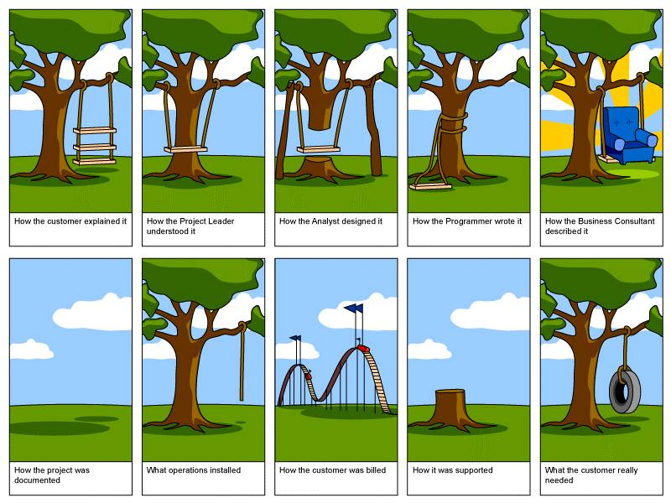
Software Development You Can’t Always Get What You Want
Notes:
See SDLC Tire Swing Video

Slide 18
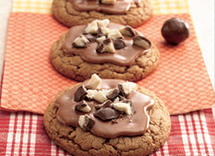

Let’s Bake Some Cookies!
Where do we start?
_________

Slide 19
Systems Development Life Cycle
Feasibility &
Planning
Goals & plans
Systems
Analysis
Business requirements
Systems
Design
Proposal
Technical Design
Systems
Implementation
Problems &
Improvements
New System
Existing System
revisions
problems
revisions
problems
Systems Maintenance: Incremental changes
Notes:
Also known as the Waterfall Development Model
Proposal: Create a new idea, etc. a new website for online help
Planning – 1 month: Check if plan is feasible, etc. time, money, available resources, HOW much does it cost, WHEN can it be finished
Goals & Plans passed on to team
System Analysis – 3-6 months: come up with what the software needs to do, what does the system need to include, WHAT do we need
Business Requirements Document (BRD) created, passed on to systems design
System Designs – 3-6 months: Technical Design Document created, HOW do we build it
Technical Design Document (TDD) passed onto system implementation
System Implementation – 2 months: test the working system privately, make sure everything works
Code created
System is tested by System Analysis team or the public
Bug or errors reported back

Slide 20
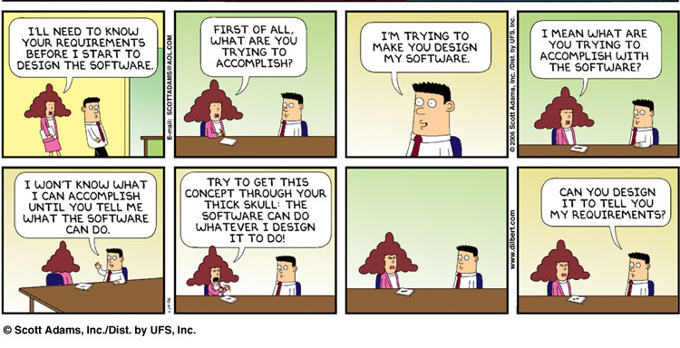
Don’t be a Numbskull!

Slide 21
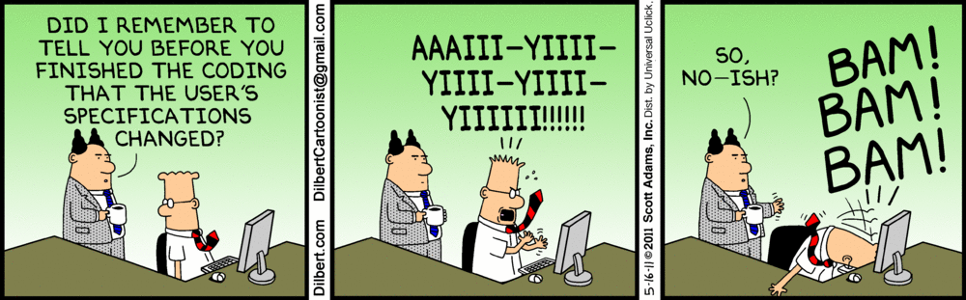
And Don’t Change Specs!

Slide 22

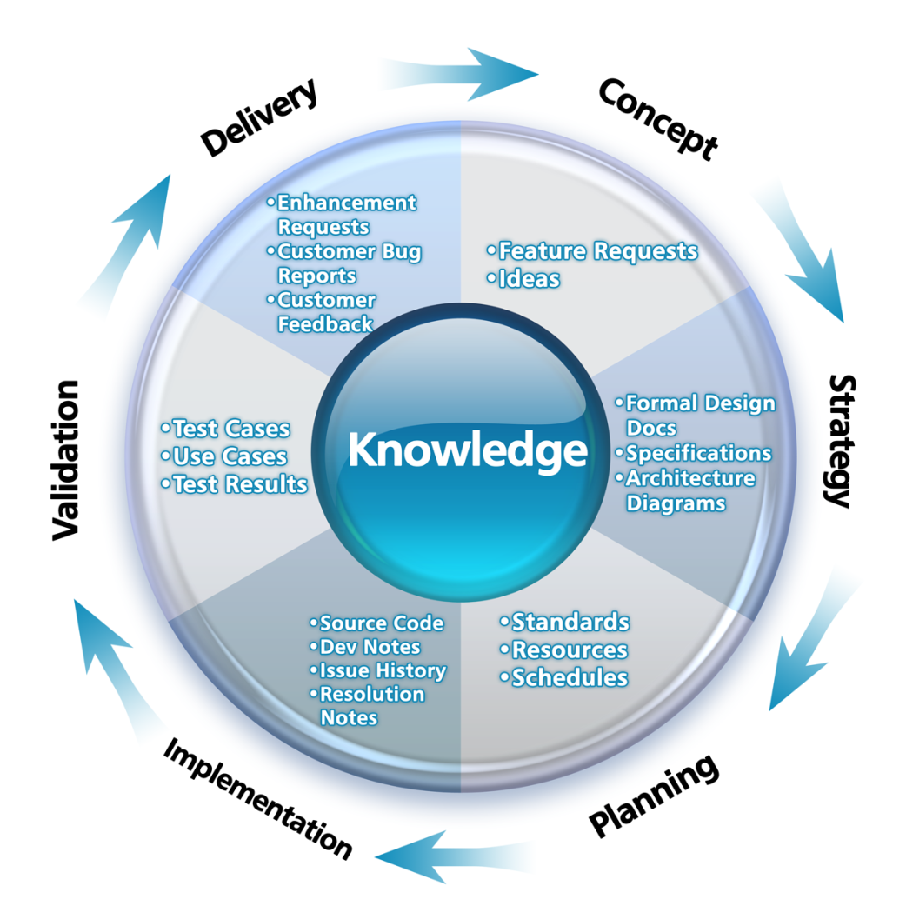
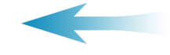
Application Lifecycle Management - % Effort
5%
10%
Delivery
Concept
Enhancement requests
Customer bug reports
Customer feedback
Feature requests
Ideas
Formal design docs
Specifications
Architecture diagrams
45%
15%
Test cases
Use cases
Test results
Strategy
Validation
Source code
Dev notes
Issue history
Resolution notes
Standards
Resources
Schedules
Planning
Implementation
15%
10%

Slide 23
Innovative Quality Assurance!
Microsoft’s Solution ☺ - WeSYP
-http://www.youtube.com/watch?v=M-c0YSsF_O0

Slide 24
What are we Talking About
Language Levels
Introduction to C++
Program Style
Libraries and Namespaces

Slide 25
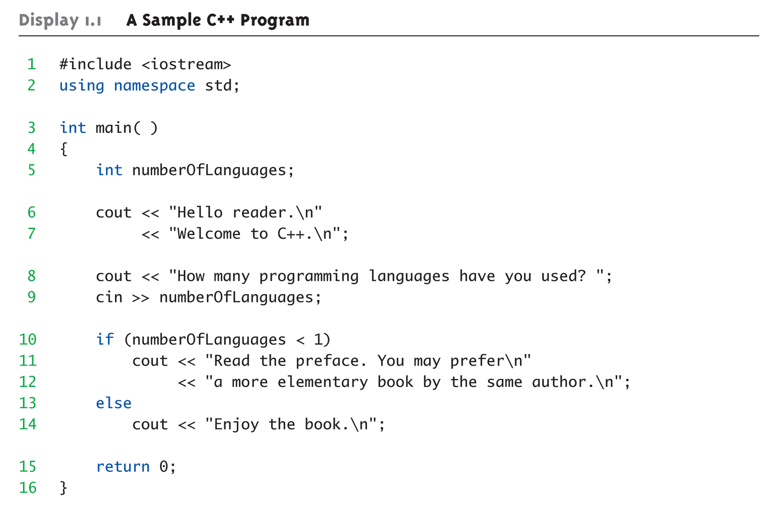
Display 1.1 A Sample C++ Program (1 of 2)
C++ Variable declaration.
What is a variable?
Variable names need to meaningful! Can’t used reserved words
Notes:
C++ Identifiers
Keywords/reserved words vs. Identifiers
Case-sensitivity and validity of identifiers
Meaningful names!
Variables
A memory location to store data for a program
Must declare all data before use in program

Slide 26
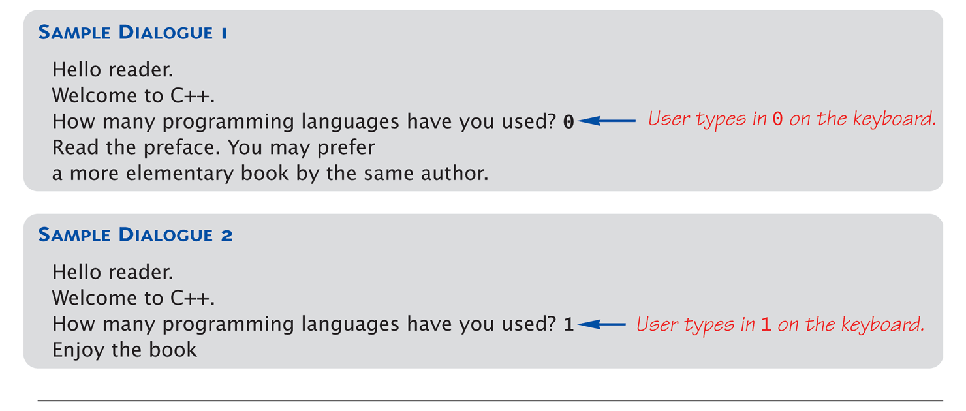
Display 1.1 A Sample C++ Program (2 of 2)

Slide 27


Program Style
Bottom-line: Make programs easy to read&modify
Comments, two methods:
// Two slashes indicate entire line is to be ignored
/*Delimiters indicates everything between is ignored*/
Both methods commonly used
Identifier naming
ALL_CAPS for constants
lowerToUpper for variables
Most important: MEANINGFUL NAMES!

Slide 28

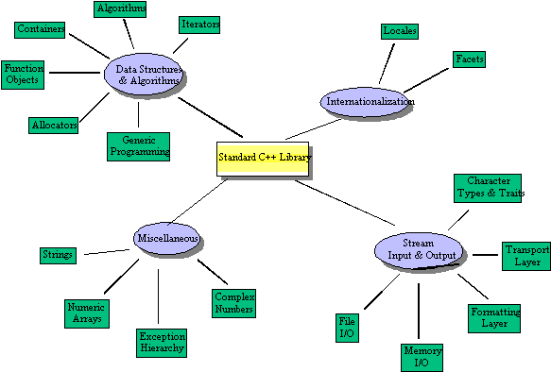
Libraries
Notes:
C++ Standard Libraries
#include <Library_Name>
Directive to "add" contents of library file to your program
Called "preprocessor directive"
Executes before compiler, and simply "copies" library file into your program file
C++ has many libraries
Input/output, math, strings, etc.

Slide 29
Namespaces
Namespaces defined:
Collection of name definitions
For now: interested in namespace "std"
Has all standard library definitions we need
Examples: #include <iostream> using namespace std;
Includes entire standard library of name definitions
#include <iostream>using std::cin; using std::cout;
Can specify just the objects we want

Slide 30
Key Takeaways
C/C++/Java/C# is foundation of many applications
Language Details
C++ is case-sensitive
Declare and initialize variables
#include C++ libraries as needed
Get In Style!
Use meaningful variable and function names
Comment your Code!

